Slide 1
UNIT-2:-Supervised Learning-Regression
Dimensionality reduction
Feature extraction,
Feature Selection
Regression Algorithms
Types of regression
Simple linear regression
Multiple linear regression
Polynomial linear regression

Slide 2
Problem With Many Input Variables
The performance of machine learning algorithms can degrade with too many input variables.
If your data is represented using rows and columns, such as in a spreadsheet, then the input variables are the columns that are fed as input to a model to predict the target variable. Input variables are also called features.
Having a large number of dimensions in the feature space can mean that the volume of that space is very large, and in turn, the points that we have in that space (rows of data) often represent a small and non-representative sample.
This can dramatically impact the performance of machine learning algorithms fit on data with many input features, generally referred to as the “curse of dimensionality.”
Therefore, it is often desirable to reduce the number of input features.
This reduces the number of dimensions of the feature space, hence the name “dimensionality reduction.”
Dimensionality reduction is a data preparation technique performed on data prior to modeling. It might be performed after data cleaning and data scaling and before training a predictive model.

Slide 3
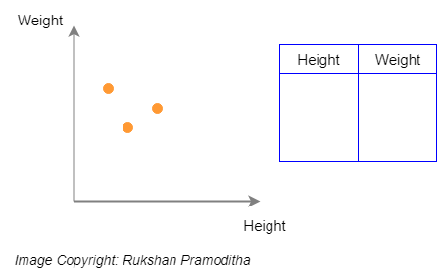
In both Statistics and Machine Learning, the number of attributes, features or input variables of a dataset is referred to as its dimensionality.
For example, let’s take a very simple dataset containing 2 attributes called Height and Weight. This is a 2-dimensional dataset and any observation of this dataset can be plotted in a 2D plot.

Slide 4
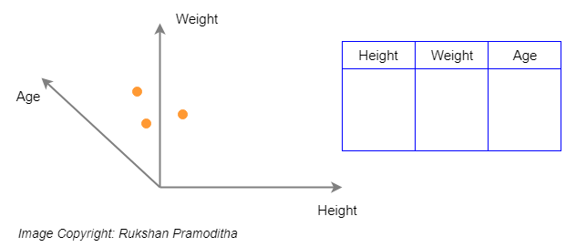
If we add another dimension called Age to the same dataset, it becomes a 3-dimensional dataset and any observation lies in the 3-dimensional space.

Slide 5
What is dimensionality reduction? Explain any one technique with example.
Dimensionality reduction:
Dimensionality reduction is a machine learning or statistical technique of reducing the amount of random variables in a problem by obtaining a set of principal variables.
This process can be carried out using a number of methods that simplify the modeling of complex problems, eliminate redundancy and reduce the possibility of the model overfitting and thereby including results that do not belong.
Dimensionality reduction is the process of reducing the number of features (or dimensions) in a dataset while retaining as much information as possible. This can be done for a variety of reasons, such as to reduce the complexity of a model, to improve the performance of a learning algorithm, or to make it easier to visualize the data.
It can be divided into feature selection and feature extraction.

Slide 6
Dimensionality reduction:
The number of input features, variables, or columns present in a given dataset is known as dimensionality, and the process to reduce these features is called dimensionality reduction.
A dataset contains a huge number of input features in various cases, which makes the predictive modeling task more complicated. Because it is very difficult to visualize or make predictions for the training dataset with a high number of features, for such cases, dimensionality reduction techniques are required to use.
Dimensionality reduction technique can be defined as, "It is a way of converting the higher dimensions dataset into lesser dimensions dataset ensuring that it provides similar information." These techniques are widely used in machine learning for obtaining a better fit predictive model while solving the classification and regression problems.

Slide 7
The process of dimensionality reduction is divided into two components:
Feature selection and
Feature extraction.
In feature selection, smaller subsets of features are chosen from a set of many dimensional data to represent the model by filtering, wrapping or embedding.
Feature extraction reduces the number of dimensions in a dataset in order to model variables and perform component analysis.

Slide 8
Question Bank
What is dimensionality reduction? Explain any one technique with example.
Explain how dimensionality can be reduced using subset selection procedure.
Differentiate between feature selection and feature extraction?
Why feature selection is important in machine learning?
Explain feature selection and feature extraction method for dimensionality reduction.
What is Feature Selection? Explain any one technique with example.
What is Feature Extraction? Explain any one technique with example.

Slide 9
There are two components of dimensionality reduction:
Feature selection: In this, we try to find a subset of the original set of variables, or features, to get a smaller subset which can be used to model the problem. It usually involves three ways:
Filter
Wrapper
Embedded
Feature extraction: This reduces the data in a high dimensional space to a lower dimension space, i.e. a space with lesser no. of dimensions.

Slide 10
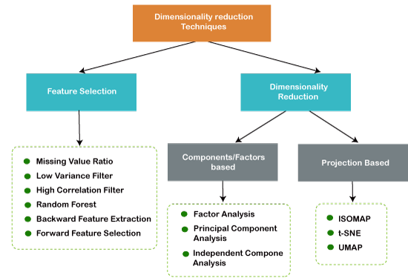

Slide 11
Methods of dimensionality reduction include:
Feature Extraction(Dimensionality Reduction) Method:
Principal Component Analysis
Linear Discriminant Analysis
Factor Analysis
Independent Component Analysis
Auto-Encoder
t-Distributed Stochastic Neighbor Embedding (t-SNE)
UMAP
Feature Selection Method:
Missing Value Ratio
Low Variance Filter
High Correlation Filter
Random Forest
Backward Feature Elimination
Forward Feature Selection

Slide 12
Differentiate between feature selection and feature extraction
Sr. No. | Feature Selection | Feature Extraction
01 | Feature selection is a process that chooses a subset of features from the original features so that the feature space is optimally reduced according to a certain criterion. | Feature extraction/construction is a process through which a set of new features is created.
02 | Feature selection is simply selecting and excluding given features without changing them. | Dimensionality reduction transforms features into a lower dimension.
03 | feature selection is about selecting the subset of the original feature set. | Feature extraction build a new set of features from the original feature set.
04 | Feature selection is a way of reducing the input variable for the model by using only relevant data in order to reduce overfitting in the model. | Examples of feature extraction: extraction of contours in images, extraction of digrams from a text, extraction of phonemes from recording of spoken text, etc.
05 | Feature selection is done in the context of an optimization problem. | Dimensionality reduction is generic and only depends on the data and not on what you plan to do with it.

Slide 13
What is Feature Selection?
Machine learning models follow a simple rule: whatever goes in, comes out. If we put garbage into our model, we can expect the output to be garbage too. In this case, garbage refers to noise in our data.
To train a model, we collect enormous quantities of data to help the machine learn better. Usually, a good portion of the data collected is noise, while some of the columns of our dataset might not contribute significantly to the performance of our model. Further, having a lot of data can slow down the training process and cause the model to be slower. The model may also learn from this irrelevant data and be inaccurate.

Slide 14
Feature selection is what separates good data scientists from the rest. Given the same model and computational facilities, why do some people win in competitions with faster and more accurate models? The answer is Feature Selection. Apart from choosing the right model for our data, we need to choose the right data to put in our model.
Feature selection is extremely important in machine learning primarily because it serves as a fundamental technique to direct the use of variables to what's most efficient and effective for a given machine learning system.
Another way to say this is that feature selection helps to give developers the tools to use only the most relevant and useful data in machine learning training sets, which dramatically reduces costs and data volume.

Slide 15
One example is the idea of measuring a complex shape at scale. As the program scales, it identifies greater numbers of data points and the system becomes much more complex. But a complex shape is not the typical data set that a machine learning system is using. These systems may use data sets that have greatly disparate levels of variance between different variables. For instance, in classifying species, engineers can use feature selection to only study the variables that will give them the most targeted results. If every animal in the chart has the same number of eyes or legs, that data may be removed, or other more relevant data points may be extracted.
Feature selection is the discriminating process by which engineers direct machine learning systems toward a target. In addition to the idea of removing complexity from systems at scale, feature selection can also be useful in optimizing aspects of what experts call the "bias variance trade-off" in machine learning.

Slide 16
Need for Feature Selection:
Before implementing any technique, it is really important to understand, need for the technique and so for the Feature Selection. As we know, in machine learning, it is necessary to provide a pre-processed and good input dataset in order to get better outcomes. We collect a huge amount of data to train our model and help it to learn better. Generally, the dataset consists of noisy data, irrelevant data, and some part of useful data. Moreover, the huge amount of data also slows down the training process of the model, and with noise and irrelevant data, the model may not predict and perform well. So, it is very necessary to remove such noises and less-important data from the dataset and to do this, and Feature selection techniques are used.
Selecting the best features helps the model to perform well. For example, Suppose we want to create a model that automatically decides which car should be crushed for a spare part, and to do this, we have a dataset. This dataset contains a Model of the car, Year, Owner's name, Miles. So, in this dataset, the name of the owner does not contribute to the model performance as it does not decide if the car should be crushed or not, so we can remove this column and select the rest of the features(column) for the model building.
Below are some benefits of using feature selection in machine learning:
It helps in avoiding the curse of dimensionality.
It helps in the simplification of the model so that it can be easily interpreted by the researchers.
It reduces the training time.
It reduces overfitting hence enhance the generalization.

Slide 17
Why is Feature Selection important?
In the machine learning process, feature selection is used to make the process more accurate. It also increases the prediction power of the algorithms by selecting the most critical variables and eliminating the redundant and irrelevant ones. This is why feature selection is important.
Three key benefits of feature selection are:
Decreases over-fitting Fewer redundant data means fewer chances of making decisions based on noise.
Improves Accuracy Less misleading data means better modeling accuracy.
Reduces Training Time Less data means quicker algorithms.

Slide 18
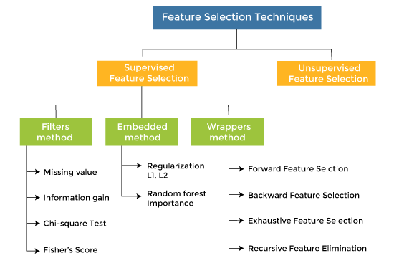
Feature Selection Techniques: There are mainly two types of Feature Selection techniques, which are:
Supervised Feature Selection technique Supervised Feature selection techniques consider the target variable and can be used for the labelled dataset.
Unsupervised Feature Selection technique Unsupervised Feature selection techniques ignore the target variable and can be used for the unlabelled dataset.

Slide 19
Forward Selection: Forward selection is an iterative method in which we start with having no feature in the model. In each iteration, we keep adding the feature which best improves our model till an addition of a new variable does not improve the performance of the model.
Backward Elimination: In backward elimination, we start with all the features and removes the least significant feature at each iteration which improves the performance of the model. We repeat this until no improvement is observed on removal of features.

Slide 20
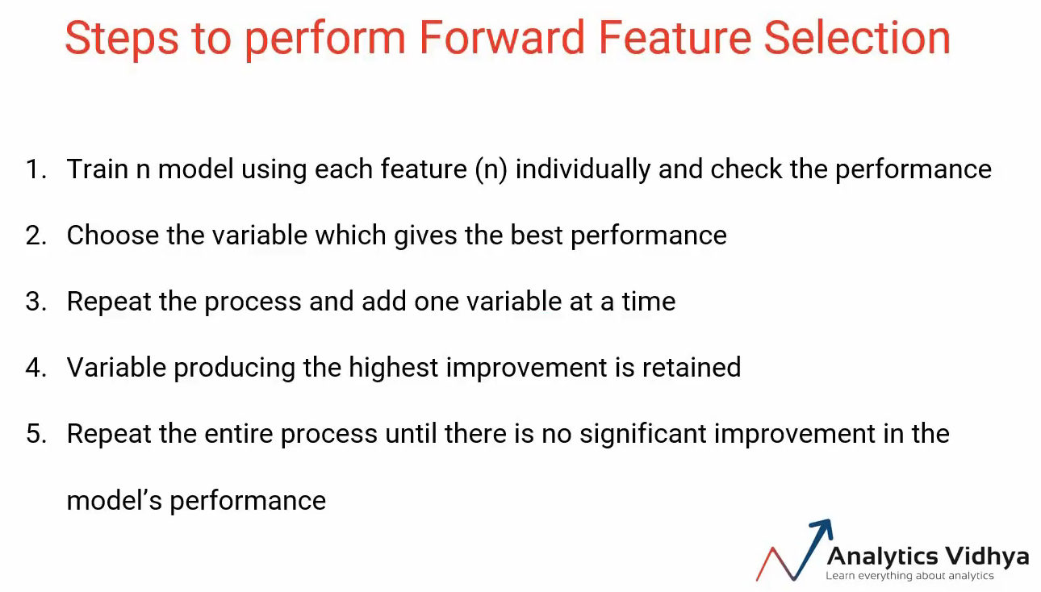

Slide 21
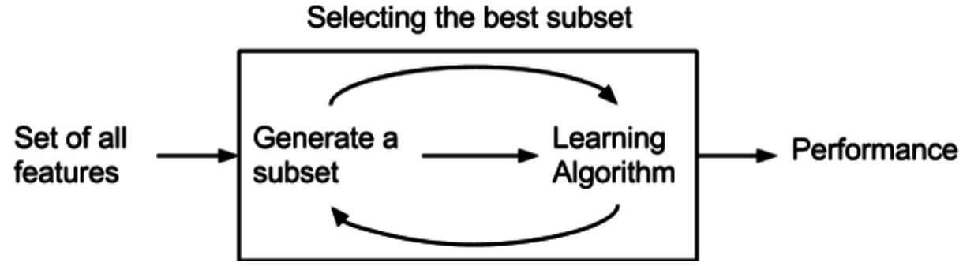
Step forward feature selection starts with the evaluation of each individual feature, and selects that which results in the best performing selected algorithm model. What's the "best?" That depends entirely on the defined evaluation criteria (AUC, prediction accuracy, RMSE, etc.). Next, all possible combinations of the that selected feature and a subsequent feature are evaluated, and a second feature is selected, and so on, until the required predefined number of features is selected.

Slide 22
What is Regression?
Regression is a supervised learning technique which helps in finding the correlation between variables and enables us to predict the continuous output variable based on the one or more predictor variables.
It is mainly used for prediction, forecasting, time series modeling, and determining the causal-effect relationship between variables.
In Regression, we plot a graph between the variables which best fits the given datapoints, using this plot, the machine learning model can make predictions about the data.
In simple words, "Regression shows a line or curve that passes through all the datapoints on target-predictor graph in such a way that the vertical distance between the datapoints and the regression line is minimum.“

Slide 23
Terminologies Related to the Regression Analysis
Dependent Variable: The main factor in Regression analysis which we want to predict or understand is called the dependent variable. It is also called target variable.
Independent Variable: The factors which affect the dependent variables or which are used to predict the values of the dependent variables are called independent variable, also called as a predictor.
Outliers: Outlier is an observation which contains either very low value or very high value in comparison to other observed values. An outlier may hamper the result, so it should be avoided.
Multicollinearity: If the independent variables are highly correlated with each other than other variables, then such condition is called Multicollinearity.

Slide 24
Types of Regression
There are various types of regressions which are used in data science and machine learning.
Some important types of regression which are given below:
Linear Regression
Logistic Regression
Polynomial Regression
Support Vector Regression
Decision Tree Regression
Random Forest Regression
Ridge Regression
Lasso Regression

Slide 25
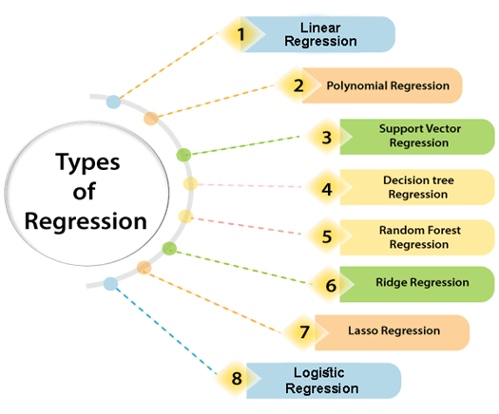

Slide 26
Linear Regression
Linear regression is a statistical regression method which is used for predictive analysis.
It is one of the very simple and easy algorithms which works on regression and shows the relationship between the continuous variables.
It is used for solving the regression problem in machine learning.
Linear regression shows the linear relationship between the independent variable (X-axis) and the dependent variable (Y-axis), hence called linear regression.
If there is only one input variable (x), then such linear regression is called simple linear regression.
if there is more than one input variable, then such linear regression is called multiple linear regression.

Slide 27
Below is the mathematical equation for Linear regression:
Y= aX+b
Here,
Y = dependent variables (target variables), X= Independent variables (predictor variables)
a and b are the linear coefficients.
Popular applications of linear regression are:
Analyzing trends and sales estimates
Salary forecasting
Real estate prediction
Arriving at ETAs in traffic.

Slide 28
Simple linear regression
Linear Regression Formula
As we know, linear regression shows the linear relationship between two variables. The equation of linear regression is similar to that of the slope formula.
Linear Regression Formula is given by the equation
Y= a + bX

Slide 29
Solved Examples:
Find a linear regression equation for the following two sets of data:
X | 2 | 4 | 6 | 8
y | 3 | 7 | 5 | 10

Slide 30
To find the linear regression equation we need to find the value of Σx, Σy, Σx2 and Σxy
Construct the table and find the value
x | y | x2 | xy
2 | 3 | 4 | 6
4 | 7 | 16 | 28
6 | 5 | 36 | 30
8 | 10 | 64 | 80
∑x=20 | ∑y=25 | ∑x2=120 | ∑xy=144

Slide 31

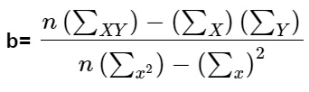
The formula of the Simple linear equation is y=a+bx.
Using the formula we will find the value of a and b
Now put the values in the equation
a= (25*120-20*144)/(4*120-(20)2)
=120/80=1.5
b= (4*144-20*25)/(4*120-(20)2)
= 76/80= 0.95
Hence we got the value of a = 1.5 and b = 0.95
The linear equation is given by y= a + bx, Now put the value of a and b in the equation
So, the equation of regression line is y = 1.5 + 0.95x

Slide 32
Multiple linear regression
So the equation of the regression line is: ^y=a+bx=11.506+12.208x.

Slide 33
Polynomial Linear Regression
Polynomial Regression is a type of regression which models the non-linear dataset using a linear model.
It is similar to multiple linear regression, but it fits a non-linear curve between the value of x and corresponding conditional values of y.
Suppose there is a dataset which consists of datapoints which are present in a non-linear fashion, so for such case, linear regression will not best fit to those datapoints. To cover such datapoints, we need Polynomial regression.
In Polynomial regression, the original features are transformed into polynomial features of given degree and then modeled using a linear model. Which means the datapoints are best fitted using a polynomial line.

Slide 34
The equation for polynomial regression also derived from linear regression equation that means Linear regression equation Y= b₀+ b₁x, is transformed into Polynomial regression equation Y= b₀+b₁x+ b₂x²+ b₃x³+.....+ b_{n}x^{n}.
Here Y is the predicted/target output,
b₀, b₁,... b_{n} are the regression coefficients.
x is our independent/input variable.
The model is still linear as the coefficients are still linear with quadratic.
This is different from Multiple Linear regression in such a way that in Polynomial regression, a single element has different degrees instead of multiple variables with the same degree.

Slide 35
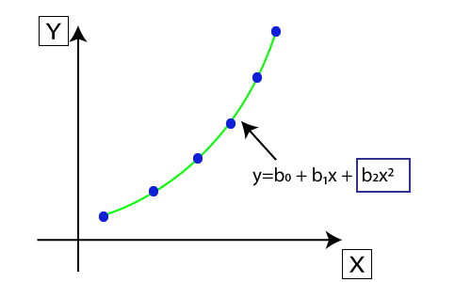
Plot between X and Y

